Slide 1
RAID LEVELS
REDUNDANT ARRAY OF INDEPENDENT DISKS

Slide 2
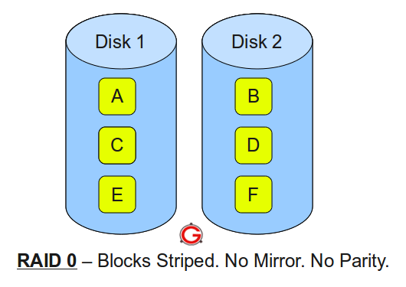
RAID 0
1. Mirroring
2. Stripping
3. Parity
Block Level – A,B
Byte Level – A1,B1
Bit Level – a1,b1

Slide 3
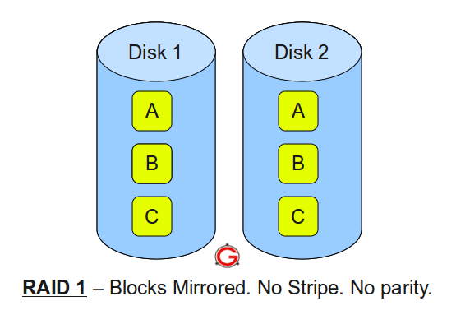
RAID 1

Slide 4
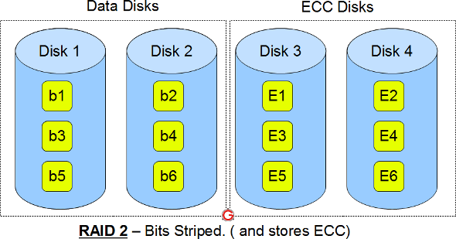
RAID 2

Slide 5
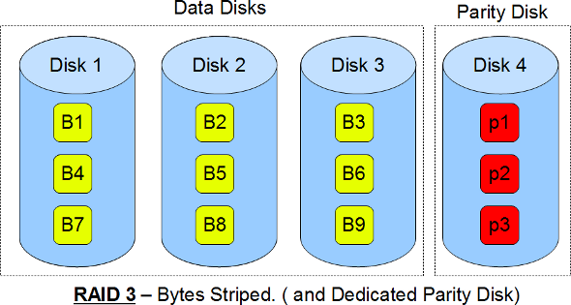
RAID 3

Slide 6
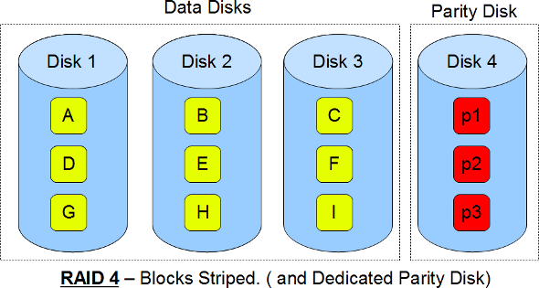
RAID 4

Slide 7
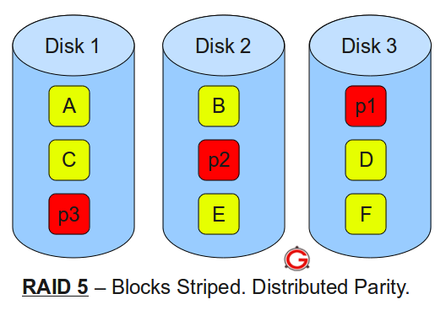
RAID 5

Slide 8
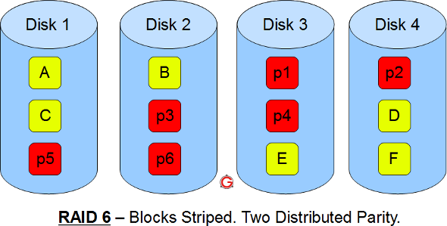
RAID 6

Slide 9
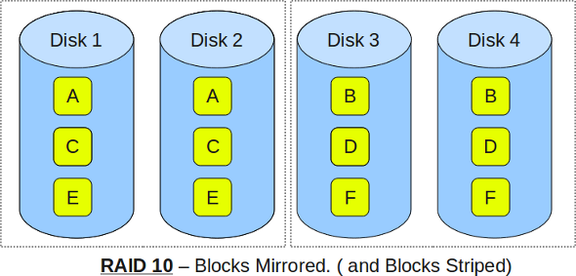
RAID 10

Slide 10
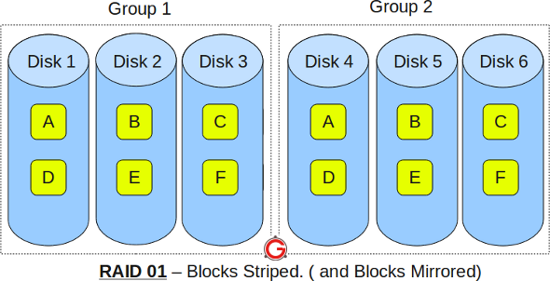
RAID 01

